Slide 1
Electrochemical simulation of Alkaline Water Electrolyzer cell by 1D model with two different types of a membrane (Anion exchange membrane and separator)
presenter
Seyed Ali Atyabi
Email: ali.atyabi@vito.be

Slide 2
Overview
Introduction
Methodology
The comparison of numerical results with experimental data
Electrolyte potential and OH- concentration distribution in the cell
Specific active surface area and the thickness of the electrode
Temperature and KOH Wt%
Sensitivity analysis
Conclusion
1/10

Slide 3
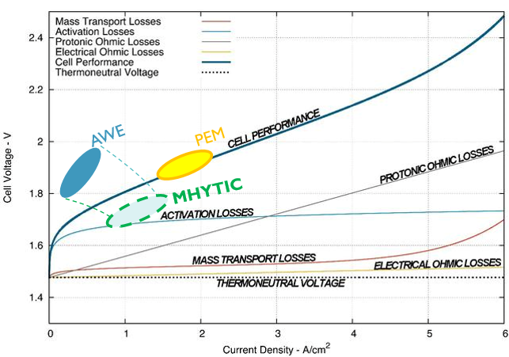
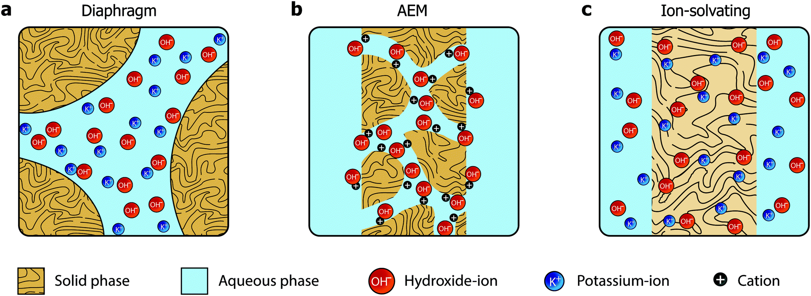
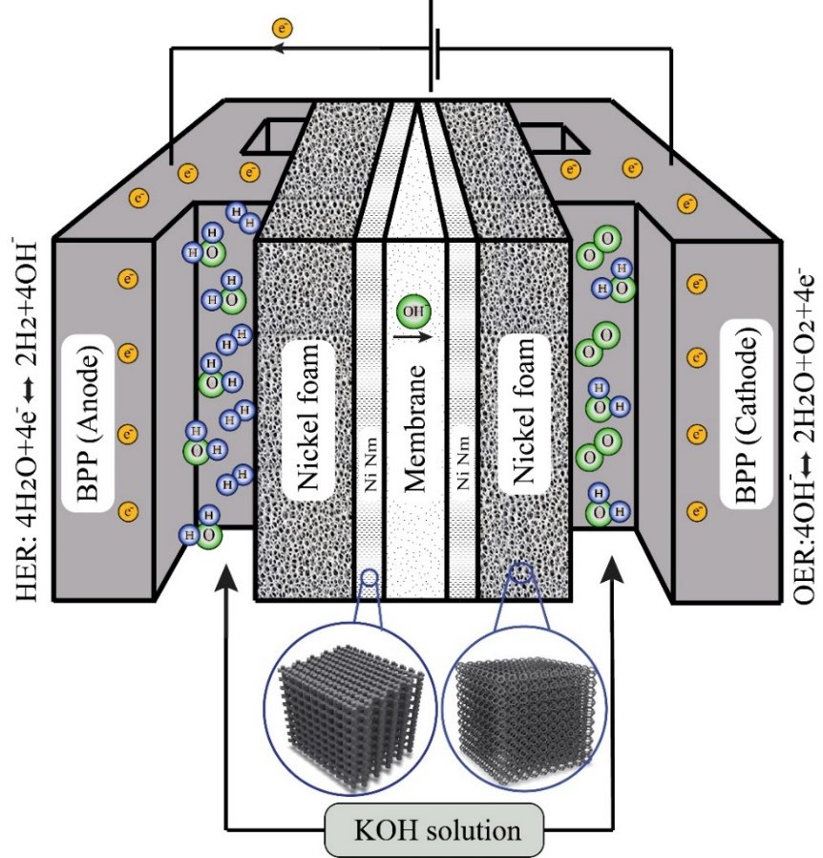
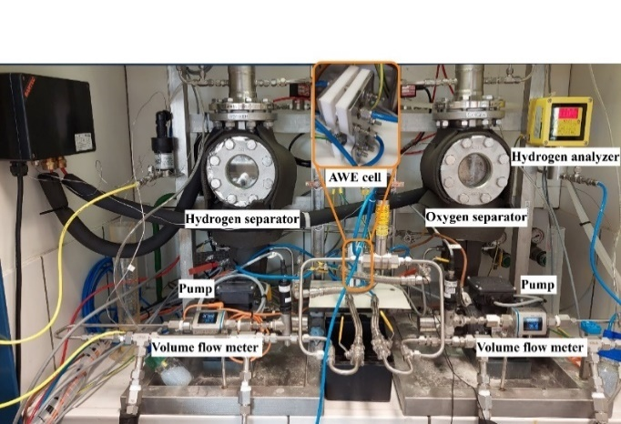
Introduction
None-selective
ionic transportation
Advantages and drawback
High gas crossover
Convection
Low conductivity
Separator
Zirfon® (500 [um])
Diffusion
Porosity=0.55
Pore size=100 [nm]
Cheap
Migration
Membrane
Selective
Electromigration
Low gas crossover
fumasep® (130 [um])
Diffusion
High conductivity
AEM
Migration
Expensive
Porosity=0.3
Pore size=3 [nm]
Electrolysis
Fuel cell
Redox batteries
Elec. Reactors
Desalinators
Adsorbent
2/10

Slide 4
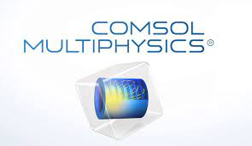
Methodology
Research question
How does membrane selection affect the performance of AWE cell?
What are we modeling?
1D model that describes the IV curve of a zero-gap alkaline water electrolyzer cell without considering bubble coverage and gas crossover
How?
Using commercial COMSOL software
What do we want to learn by modeling?
Electrolyte potential and OH- concentration distribution in the domain, supersaturation region far from the membrane, effect of temperature, KOH Wt%, NM electrode thickness, and active area on the polarization curve of cell
Assumptions
AWE operates at steady state, single phase, and isothermal conditions at ambient pressure
Hydrodynamics effects and convective flow through the porous electrodes are neglected
Effect of gas bubble coverage is taken into account after estimation by 2d model
A Bruggman modification is used to estimate both the transport phenomena inside the electrodes as well as the effective electrical conductivity
we did not consider the contact resistance between the current collector and the nickel foam
Foam
NM
Membrane
NM
Foam
Governing equations
Electrochemical reactions for the cathode and anode; Butler-Volmer; Nernst-Planck; Tertiary Current Distribution; Nucleation theory
3/10

Slide 5
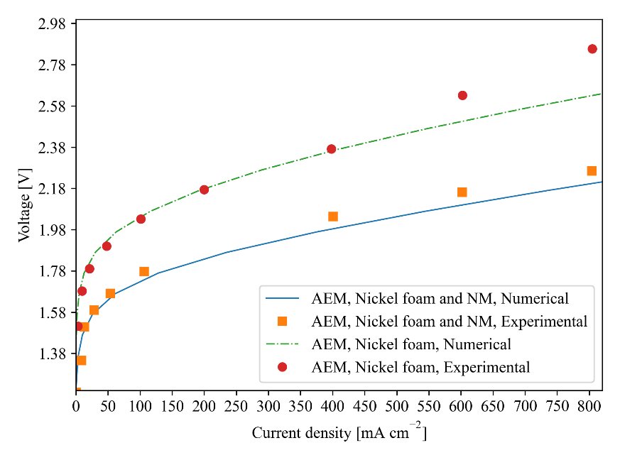
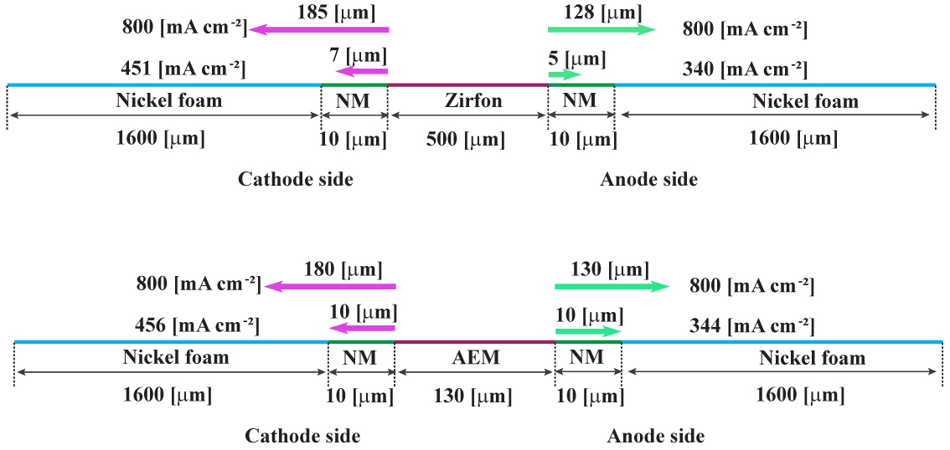
The comparison of numerical results with experimental data
In order to evaluate the tendency of the system to form gas bubbles, the supersaturation level must be determined.
AEM
Zirfon
Numerical and experimental polarization curves at 5.4 Wt.% KOH, P =1 [atm] and T =343 [K] for AEM with Nickel foam and Nickel foam and NM
Supersaturation region from membrane
4/10

Slide 6
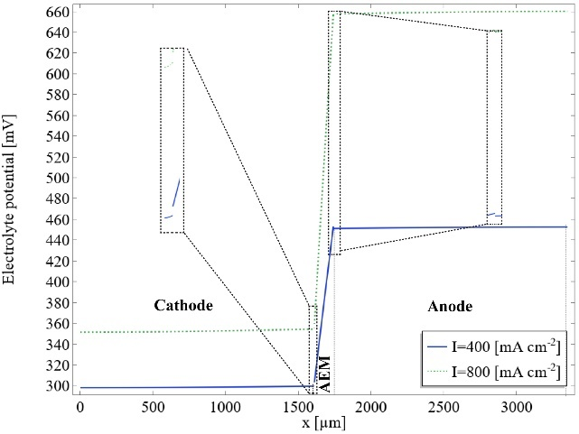
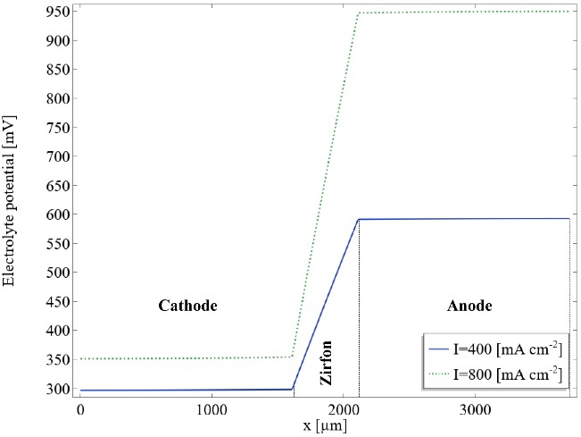
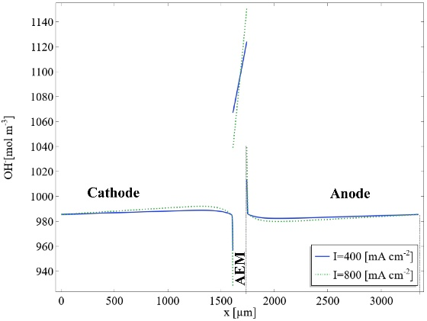
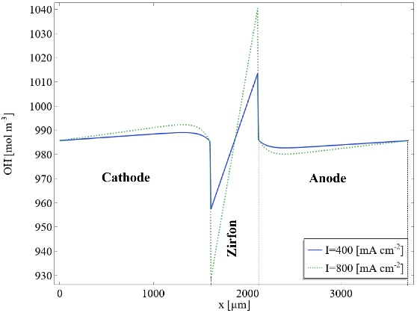
Electrolyte potential and OH- concentration
AEM
Zirfon
Electrolyte potential of AWE cell at 5.4 Wt.% KOH, P =1 [atm] and T =343 [K] for AEM and Zirfon
5/10
AEM
Zirfon
Concentration of OH- ion for AEM and Separator in a cell at 5.4 Wt.% KOH, P=1 [atm] and T =343 [K]

Slide 7
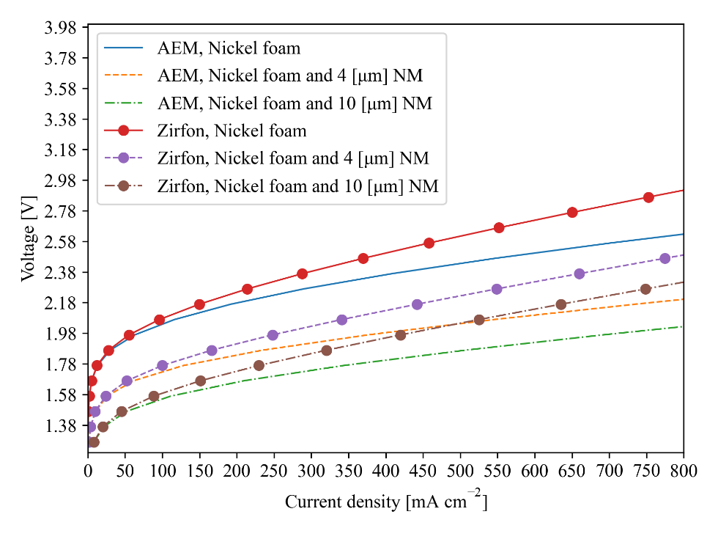
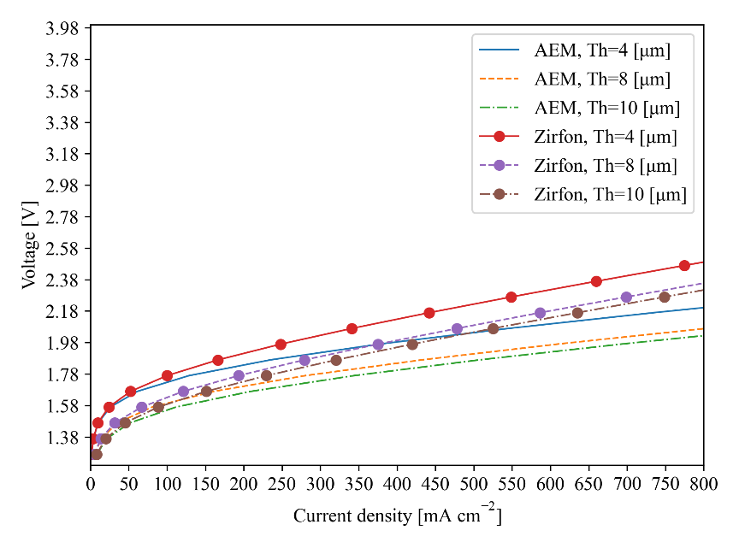
Specific active surface area and the thickness of the electrode
Polarization curves at different electrode thickness at 5.4 Wt.% KOH, P =1 [atm], T = 343 [K] for both AEM and separator
Polarization curves at the different specific surface active
(Nickel foam and NM) at 5.4 Wt.% KOH, and P=1 [atm] and T=343 [K]
6/10

Slide 8
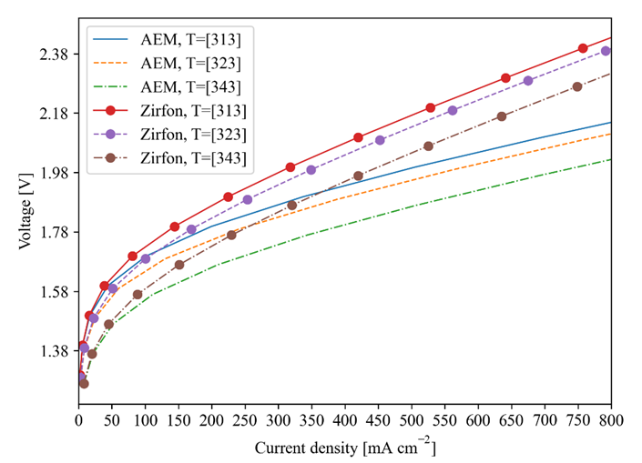
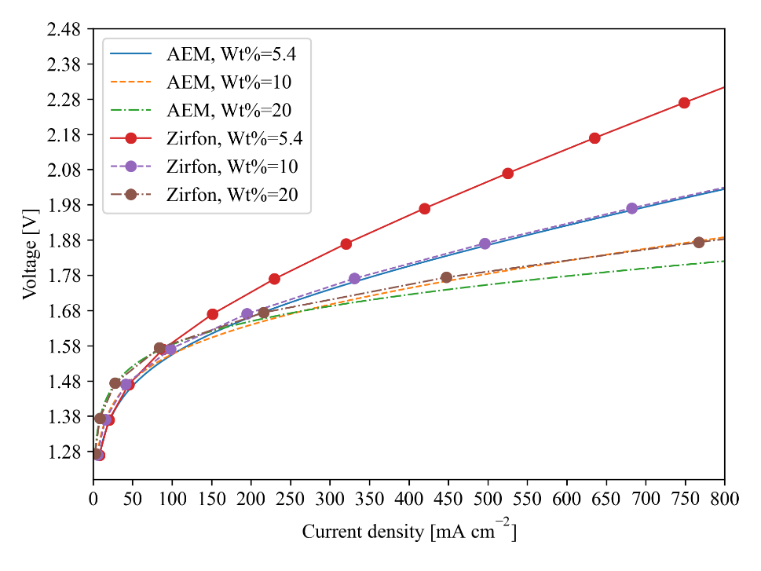
Temperature and KOH Wt%
Polarization curve at different temperatures (313–343 [K])
10[um] NM electrode at P=1 [atm] at 5.4 Wt.% KOH for both AEM and Zirfon
Polarization curve at different electrolyte weight percent (5.4 - 20 KOH Wt.%) 10[um] NM electrode at P=1 [atm] and T=343 [K] for AEM and zirfon
7/10

Slide 9
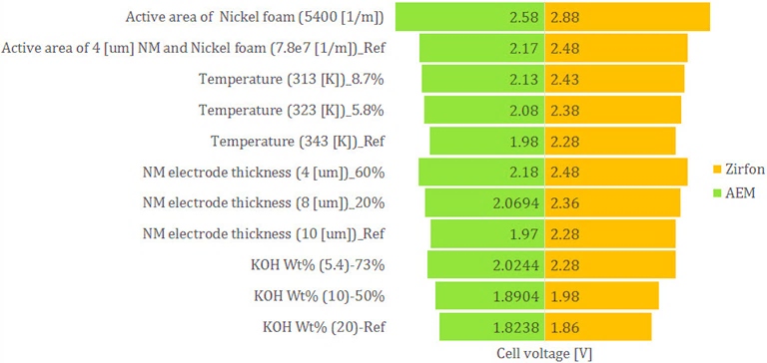
Sensitivity analysis
Tornado charts graph for sensitivity analysis of
KOH Wt%, NM thickness, temperature, specific active area
@ 800 [mA cm-2]
8/10

Slide 10
Conclusion
In this study, we compared the behavior of two types of membrane in AWE without considering gas crossover
Zirfon and AEM behave different in OH- concentration distribution and overpotential gradient
AEM outperforms zirfon in overpotential specifically at low KOH concentration
The most sensitive parameter in the model that affect the cell potential is the specific active area of porous electrode
The model allows to further optimize the properties of AEM and zirfon as well as the operational conditions of AWE cell
For the future steps, we want to consider the effect of gas crossover and bubble coverage with a multiphase model
9/10

Slide 11



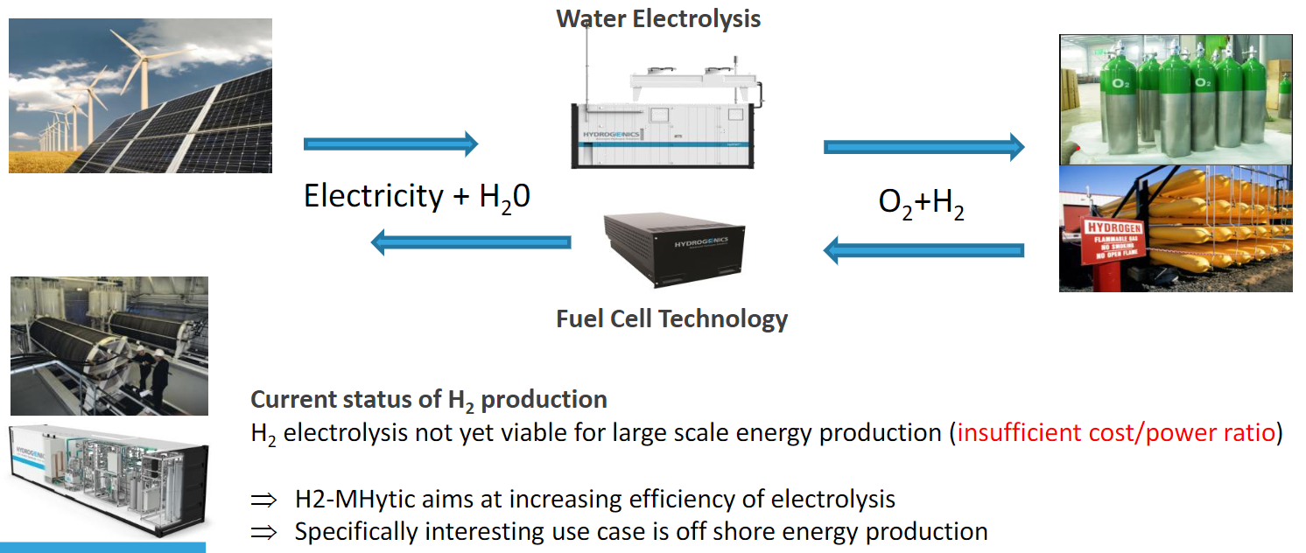
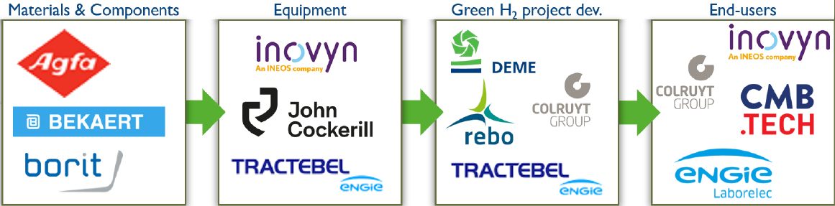



Acknowledgment
This work was performed in the framework of the 2010462_MHYTIC project(Membrane Integrated High Surface Area Nanomesh Technology)
Research partners
Industrial advisory board
Funded by
10/10

